Slide 1

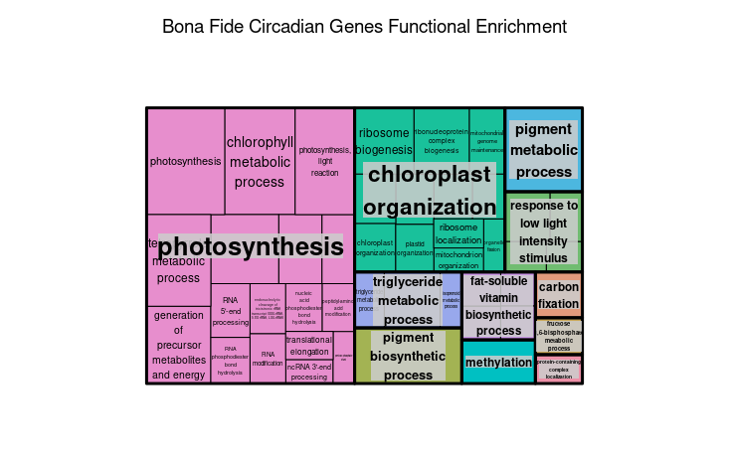
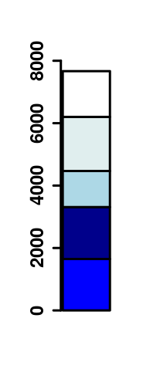
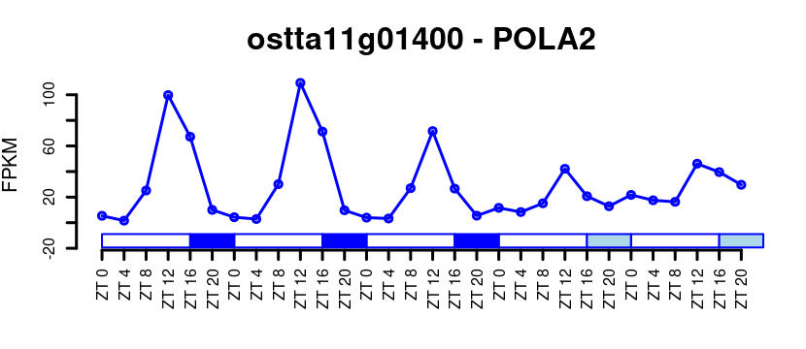
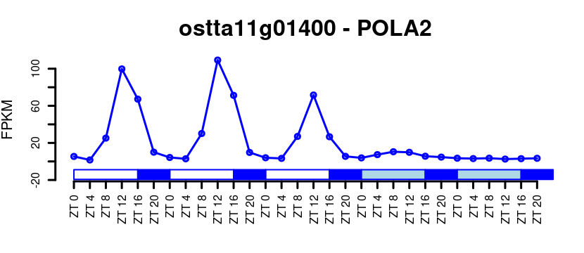
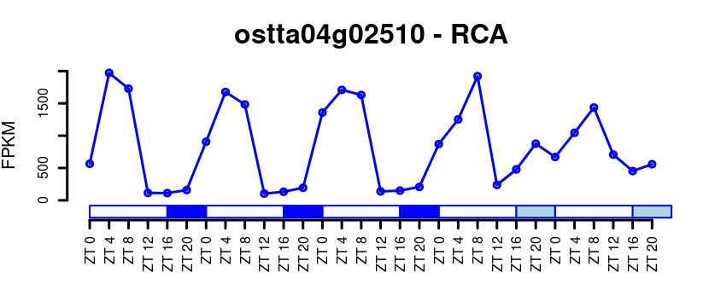
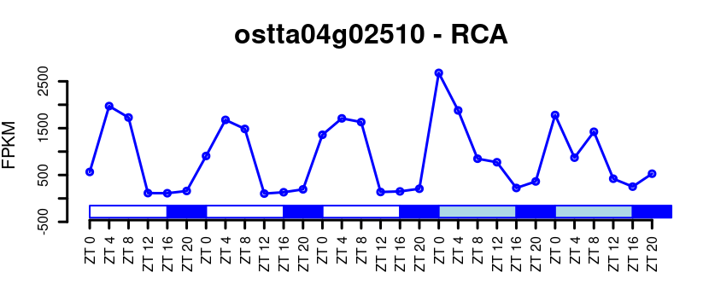
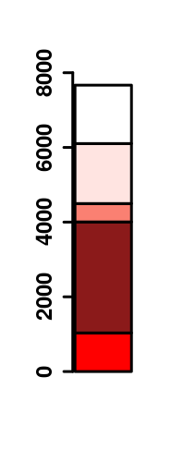
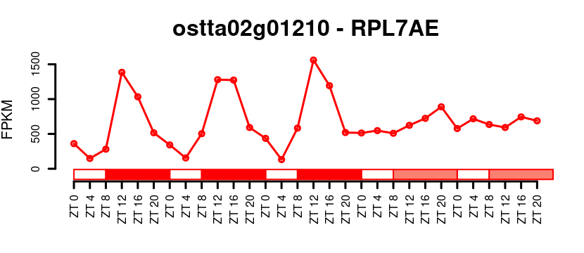
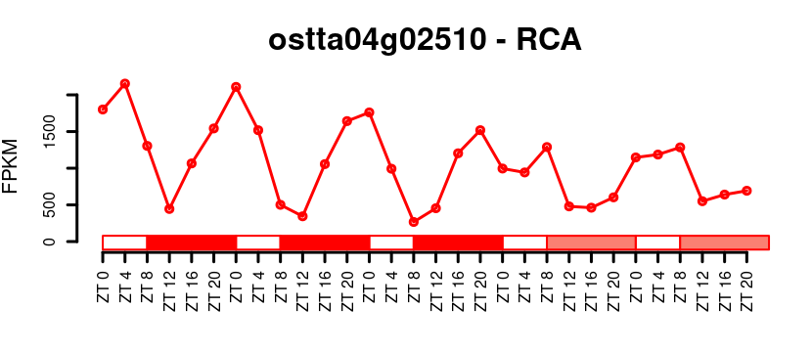
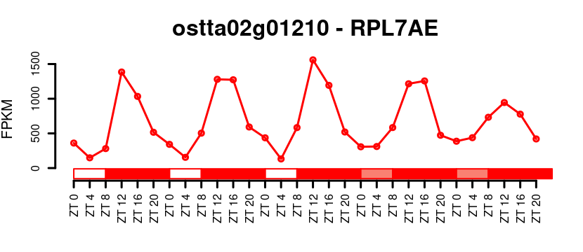
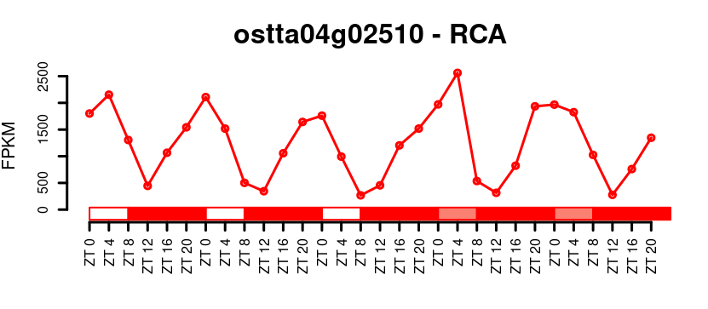
(A)
(B)
(G)
Rhythmic
LD
SD
LD
SD
Non rhythmic
Max Expression (FPKM)
1297
350
684
929
5272
832
(H)
(C)
(D)
Non Rhythmic LD
Rhythmic only LD
Rhythmic LD/LL
Rhythmic LD/DD
(I)
Rhythmic LD/LL/DD
(E)
(F)
Non Rhythmic SD
Rhythmic only SD
Rhythmic SD/LL
Rhythmic SD/DD
Rhythmic SD/LL/DD

